Slide 1
Weekly Report
Group 3

Slide 2
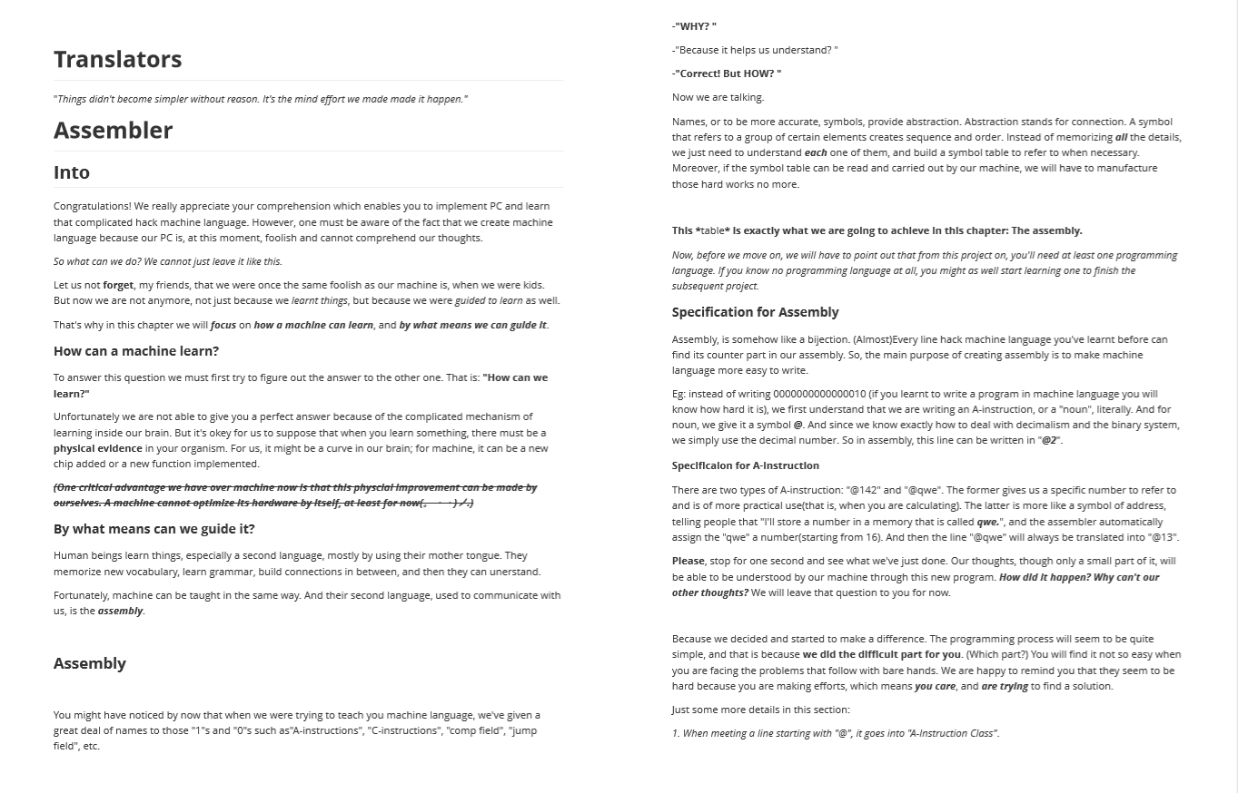

Slide 3
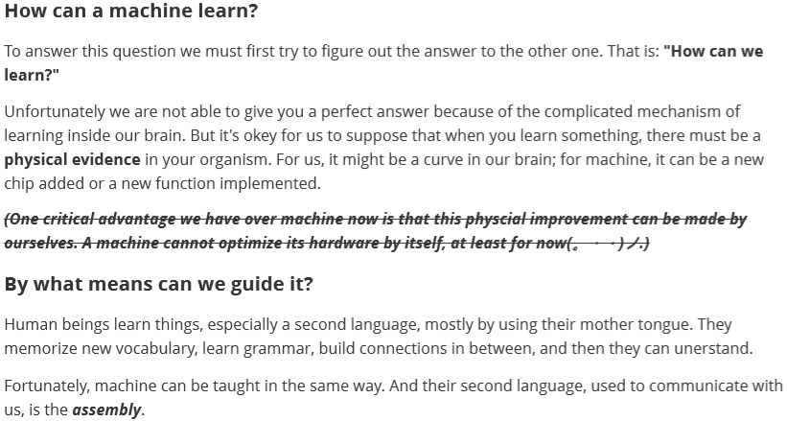
Natural Connections
In our publication, we intend to show more natural connection. In this particular section, it is the connection between and programming languages human languages. Moreover, we give a hint to the readers about human thoughts and how our mind works so that they will be aware of the difference.

Slide 4
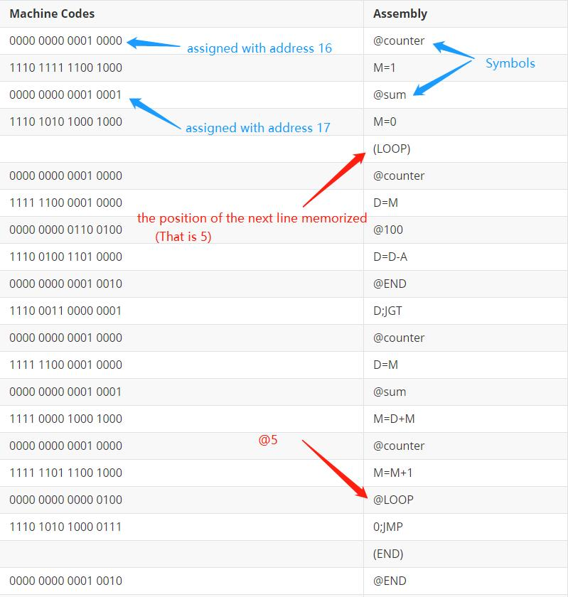
More specific explanations
We provide more detailed explanations for readers to comprehend.

Slide 5
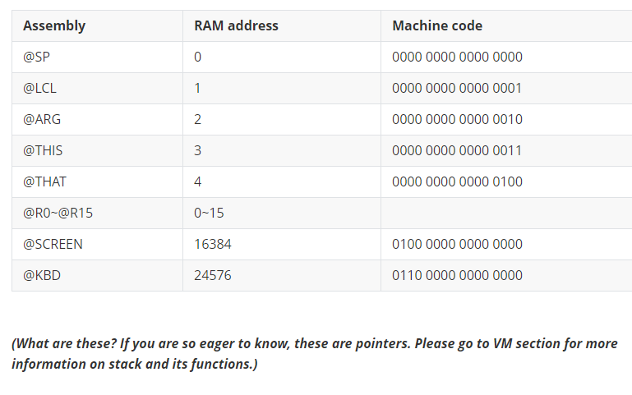
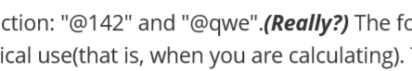

Keep asking questions
Some are answered
Some are not

Slide 6
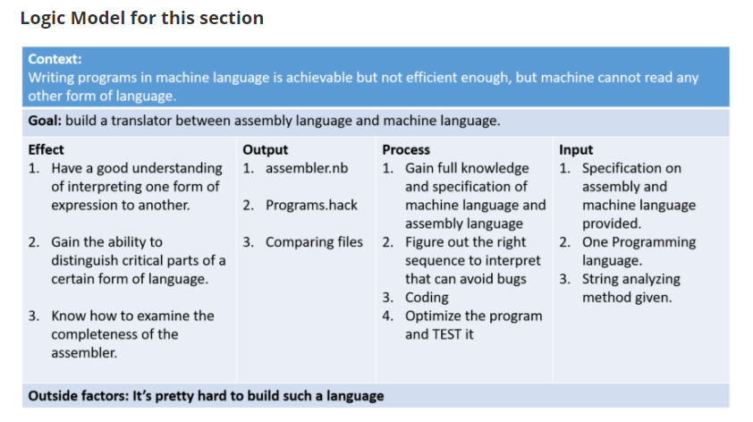
And a logic model at the end

Slide 7
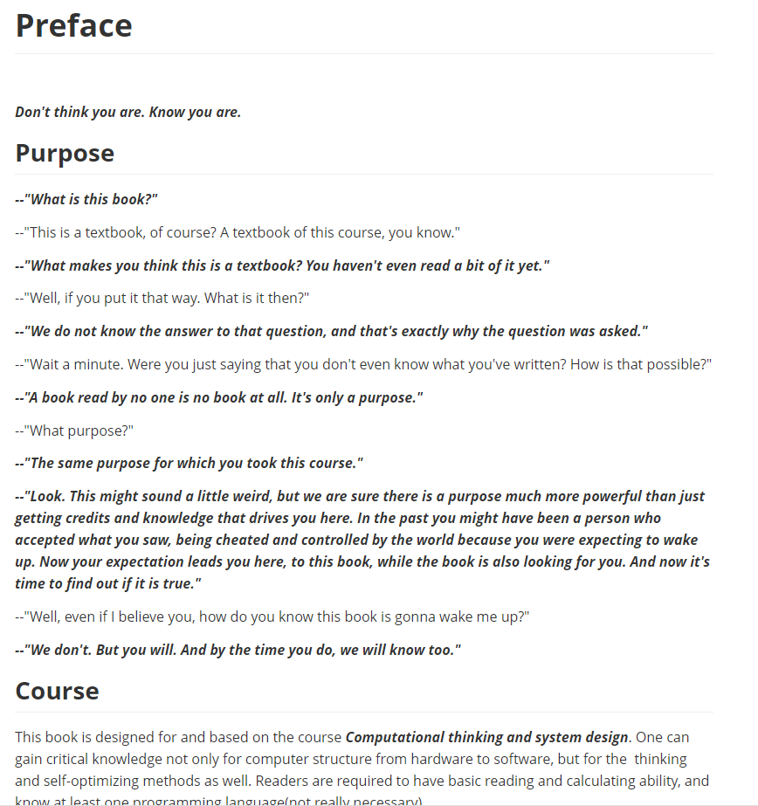
Our Preface

